Slide 1

Projet n°2126 Affichage Matriciel
Phase de Design
Ricardo Crespo
2 février 2022

Slide 2



Table des matières
Description du produit
Schéma blocs
Aspects techniques du schéma
Conclusion
Questions

Slide 3
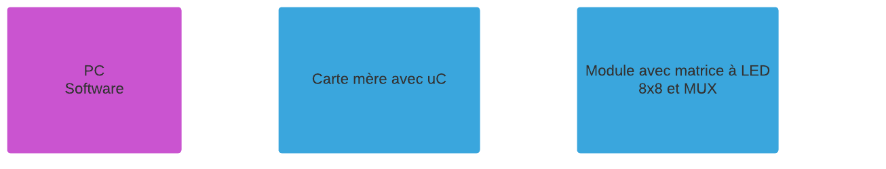
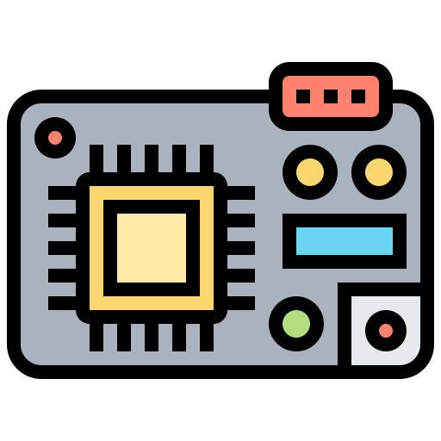


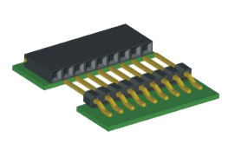
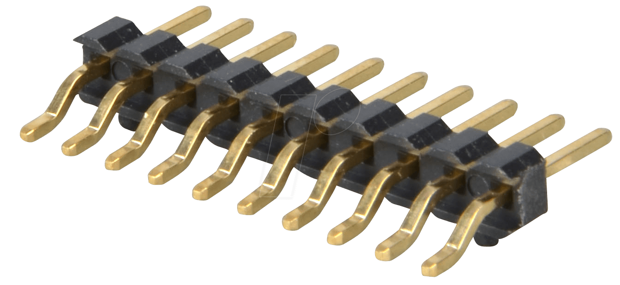
Schéma bloc général

Slide 4
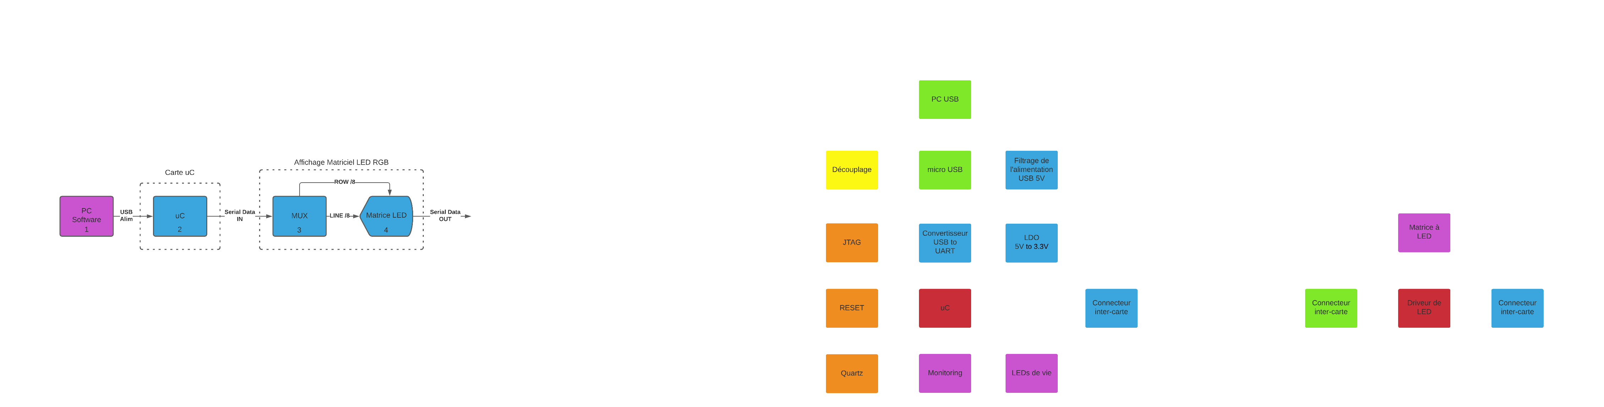
Main board
A
G
B
C
H
E
D
I
F
M
J
K
L

Slide 5
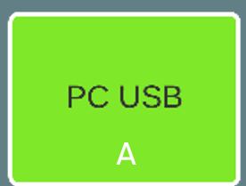
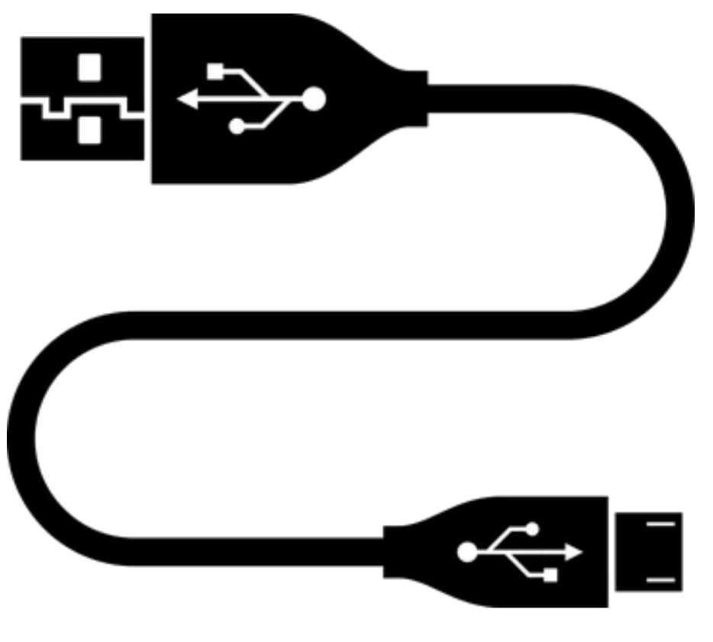
PC USB

Slide 6
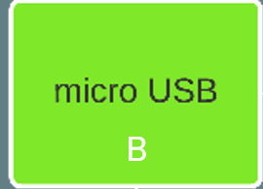
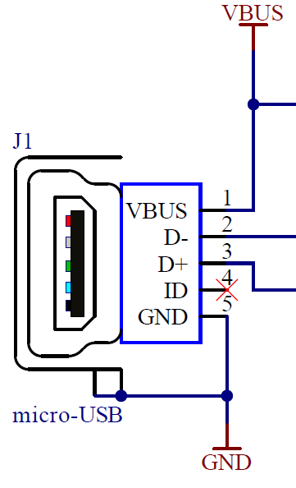
micro USB

Slide 7

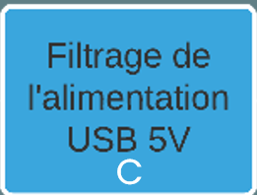

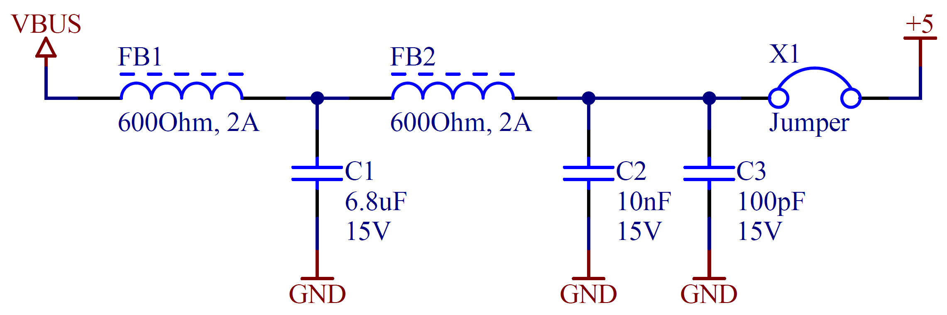
Filtrage 5V

Slide 8
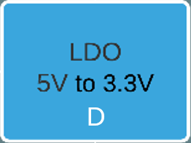
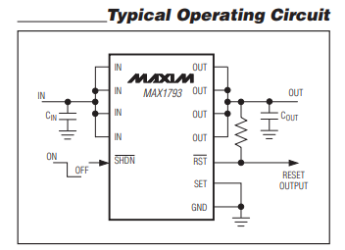
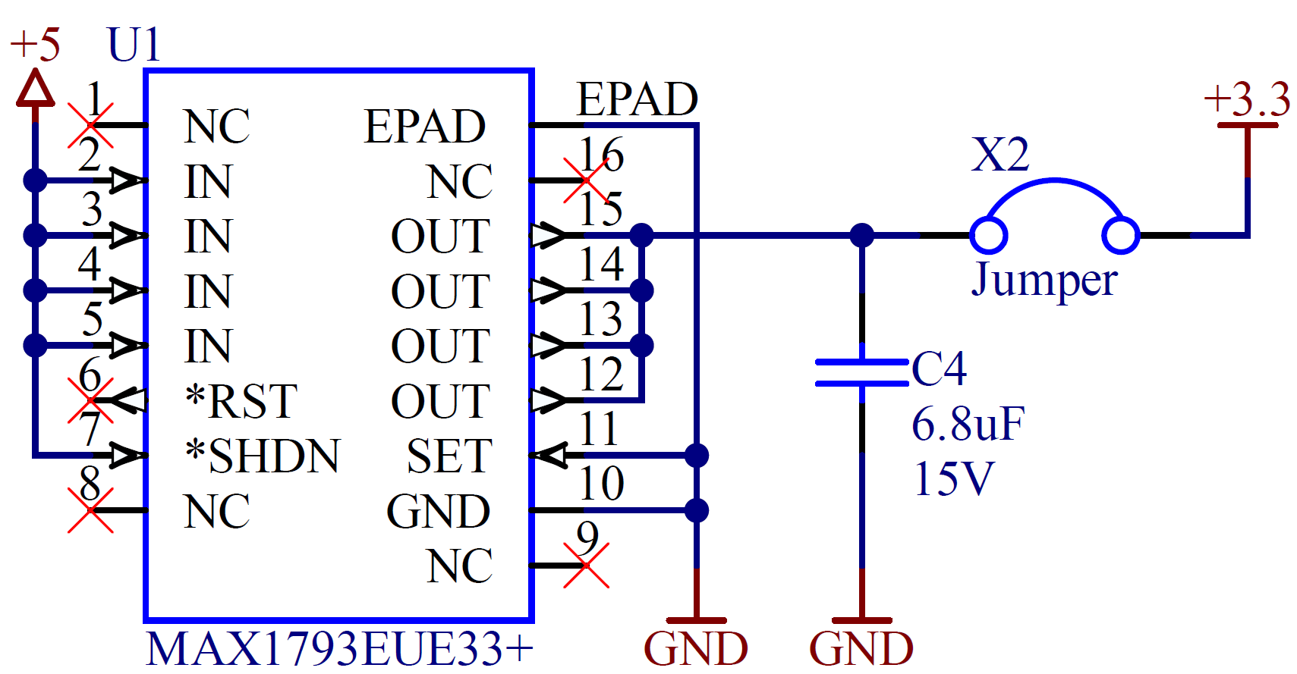
LDO 5V to 3.3V

Slide 9
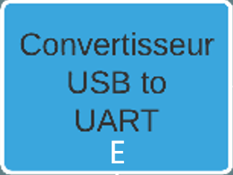
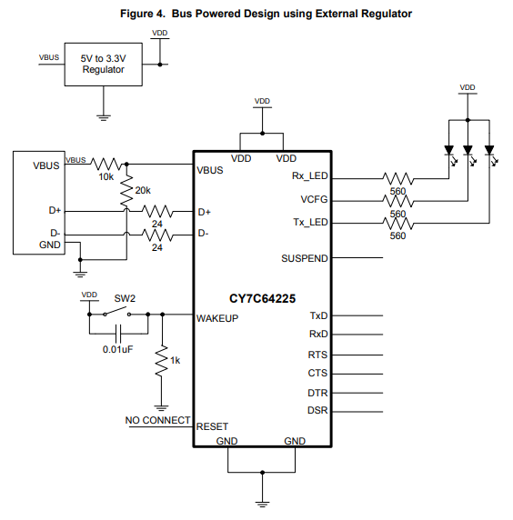
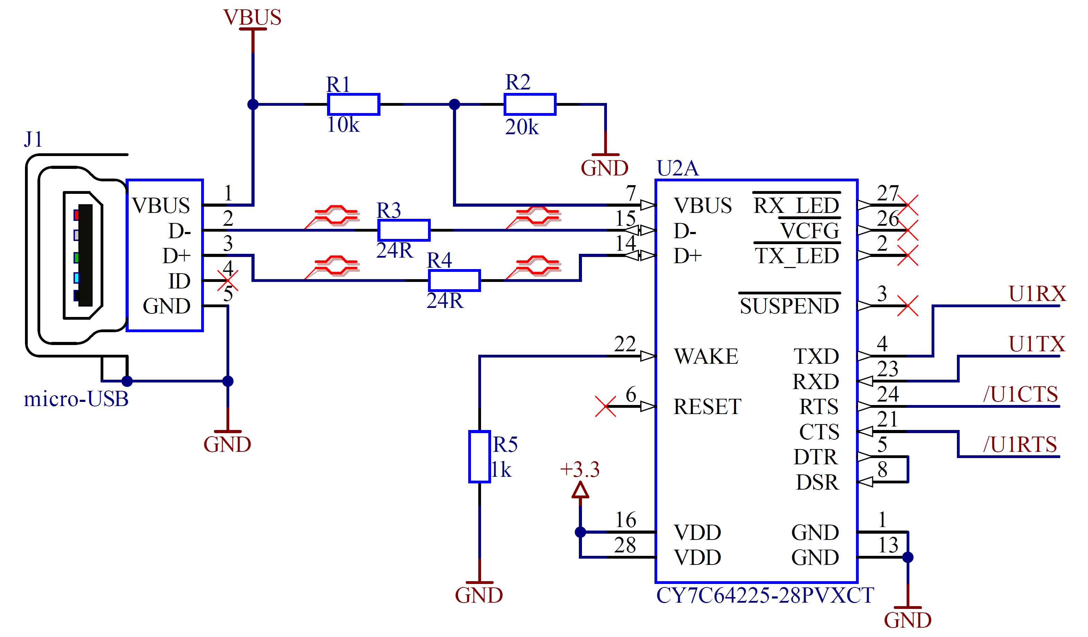
Convertisseur USB to UART

Slide 10
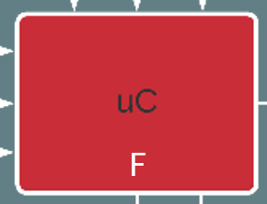
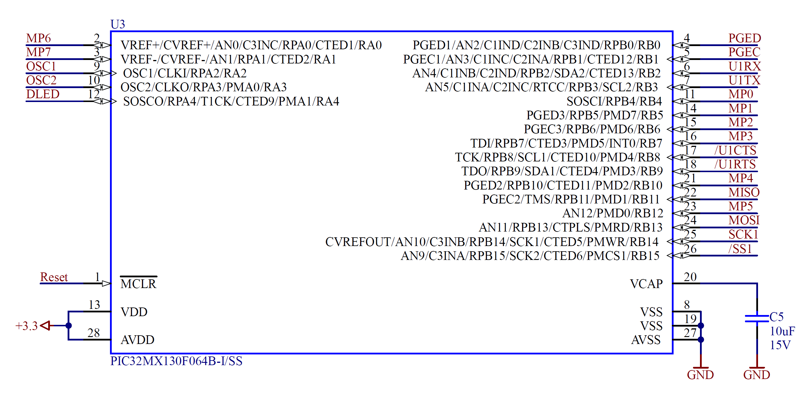

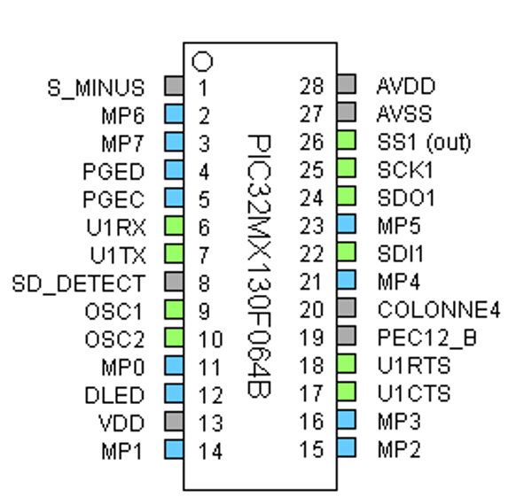
Microcontrôleur

Slide 11

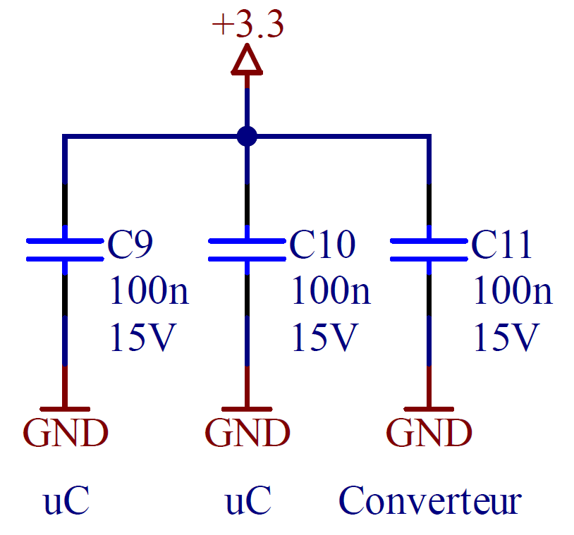
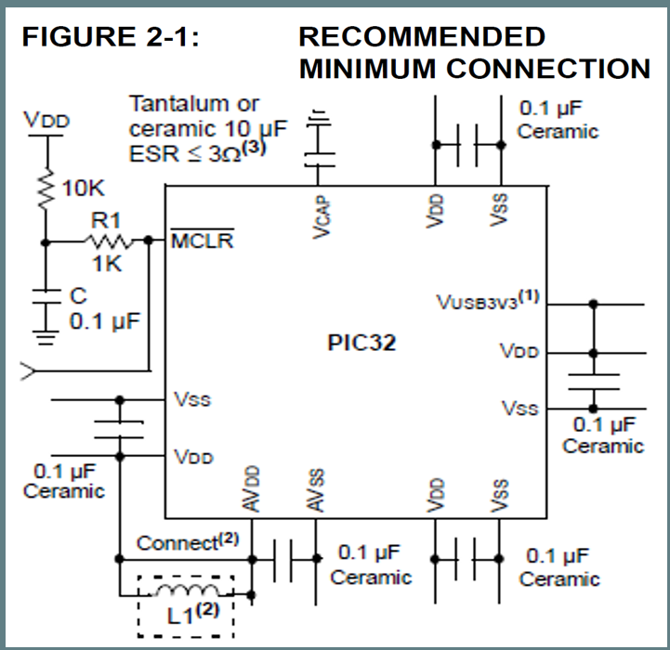
Découplage

Slide 12
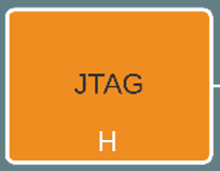
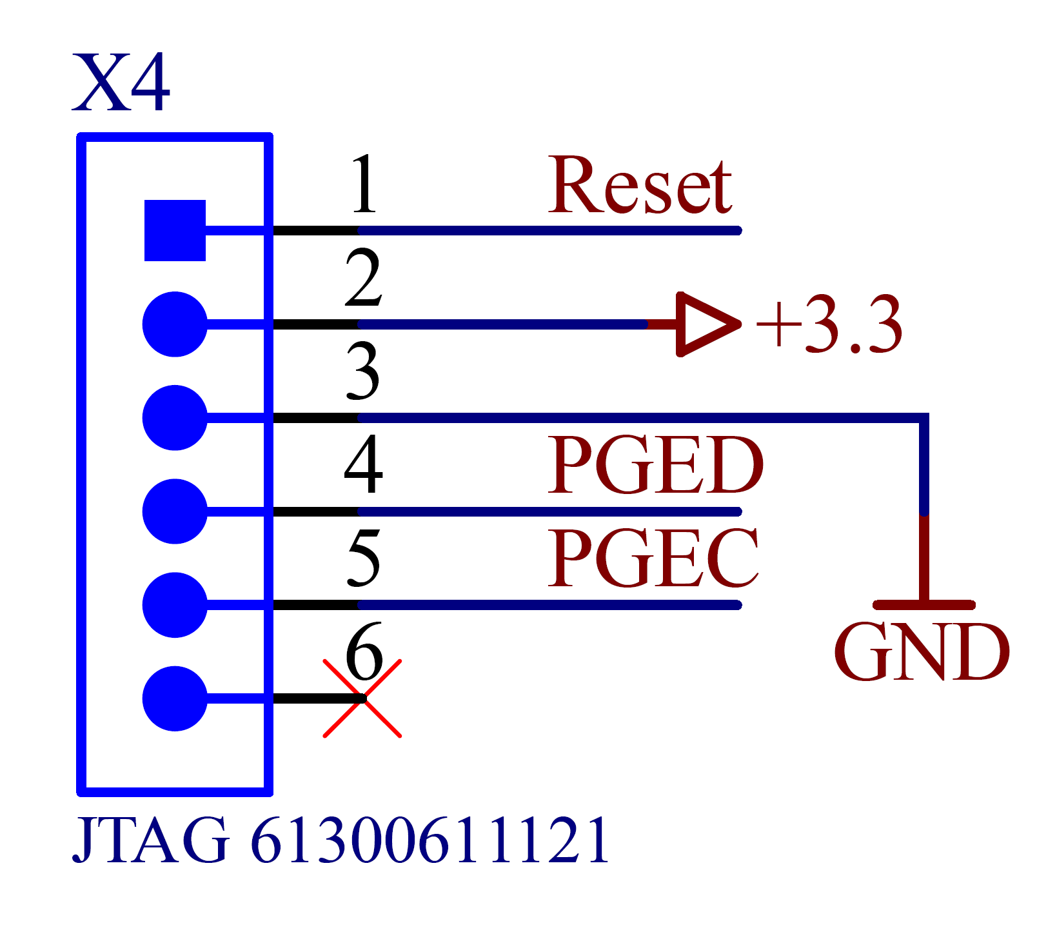
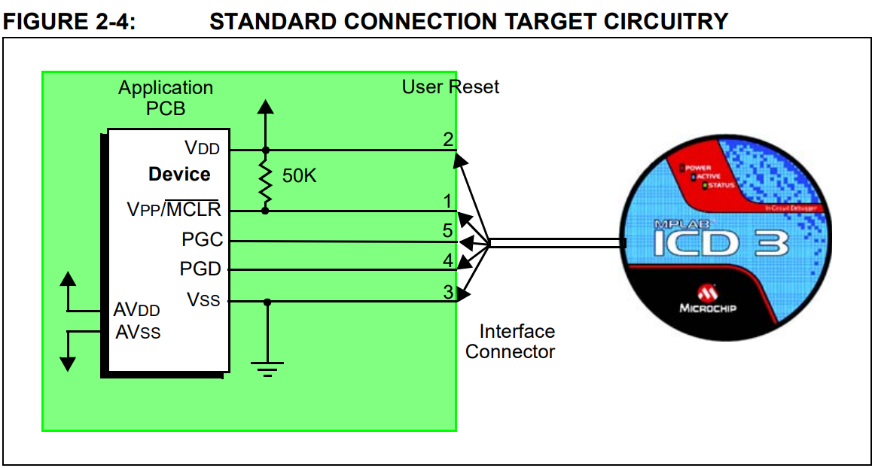

JTAG

Slide 13
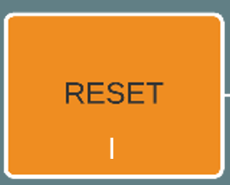
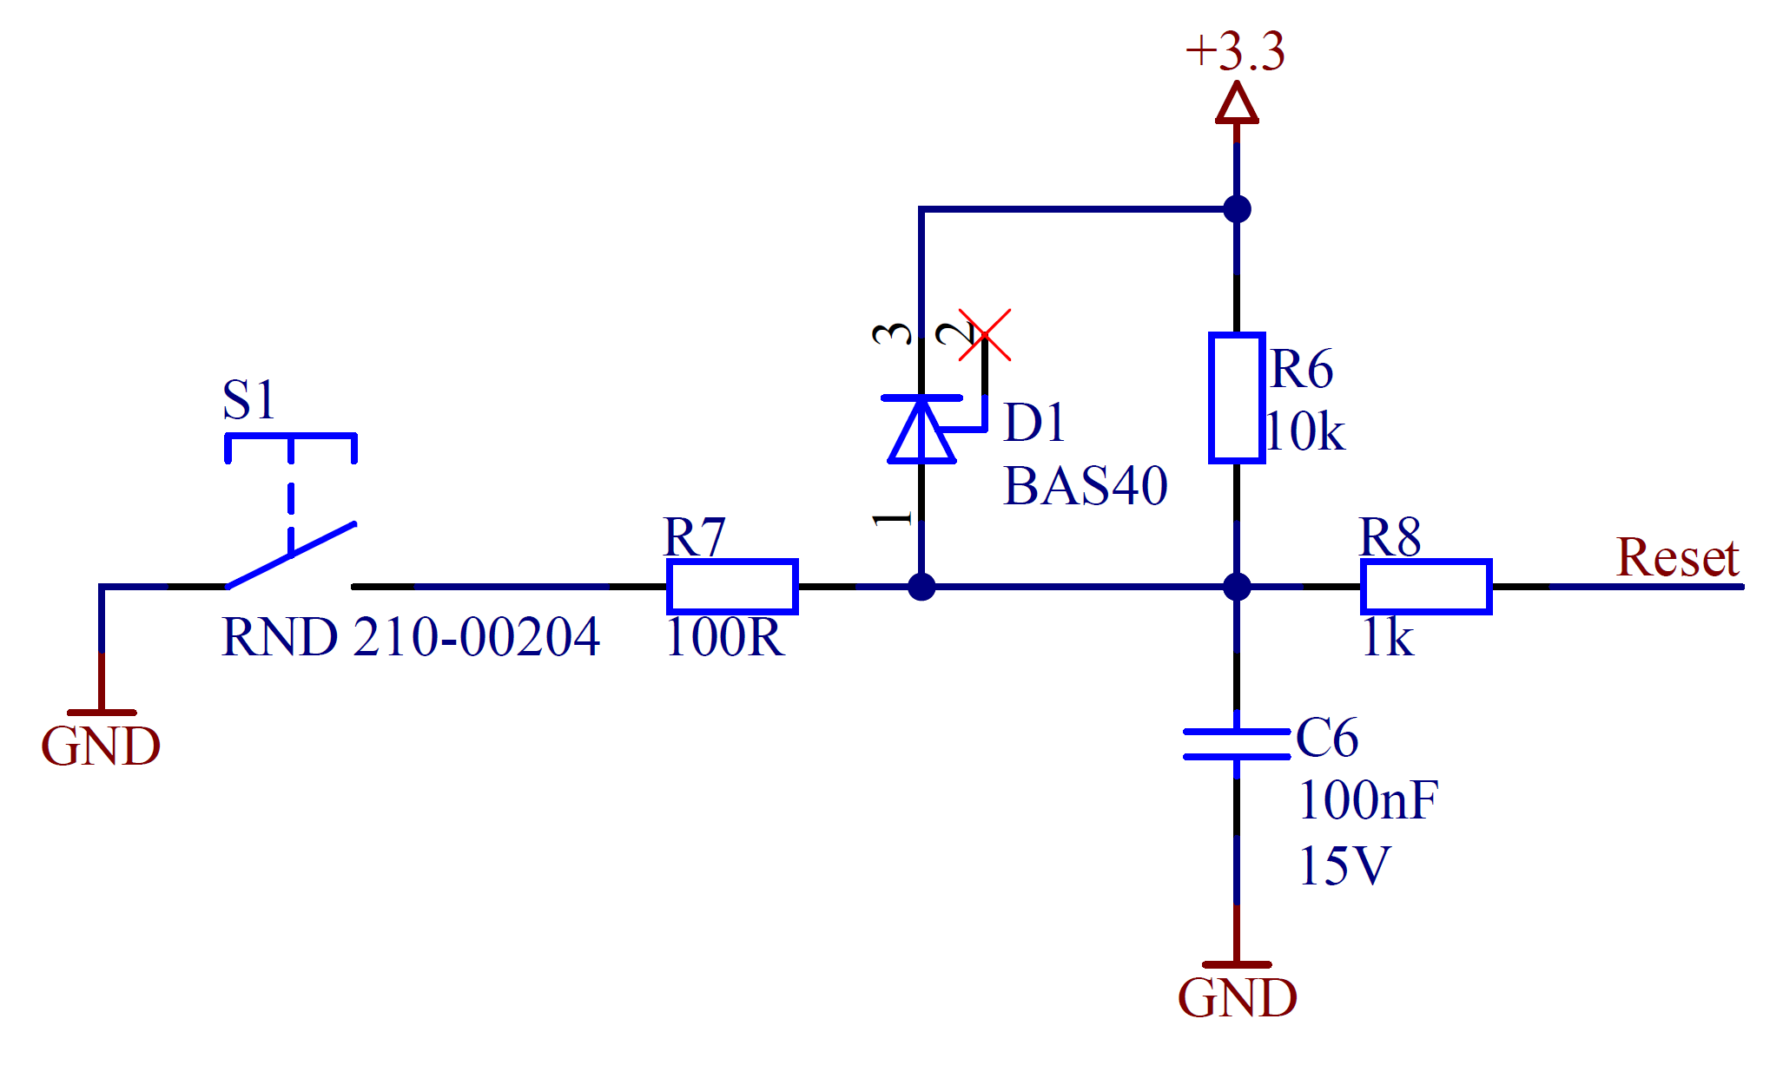

RESET

Slide 14
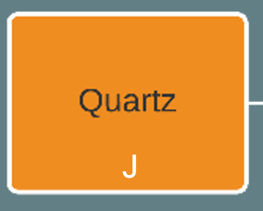
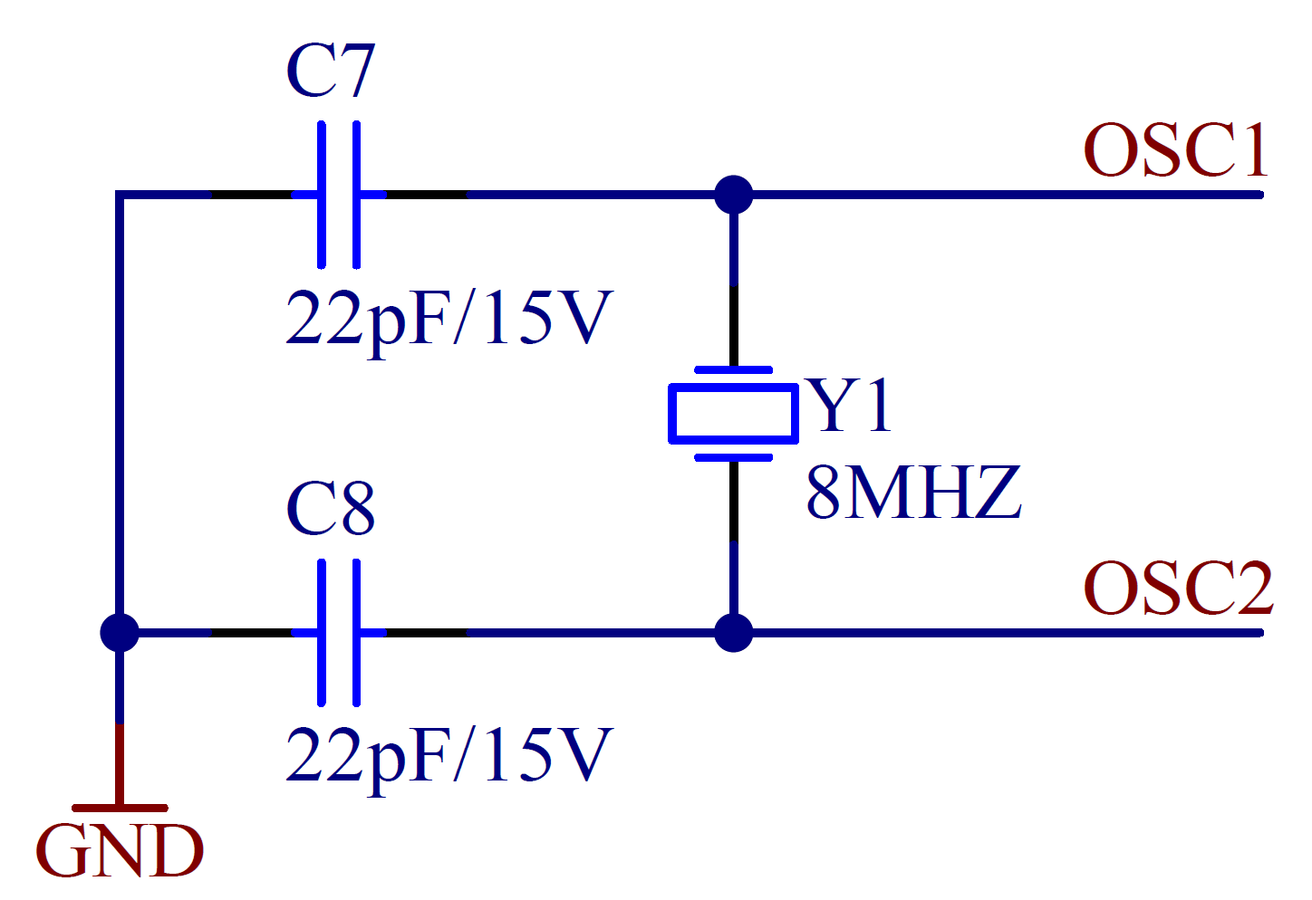
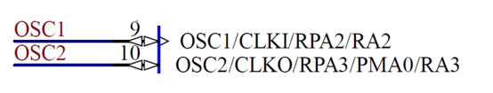
Quartz

Slide 15
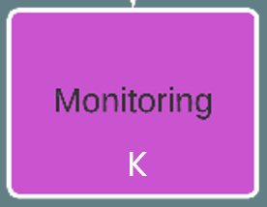
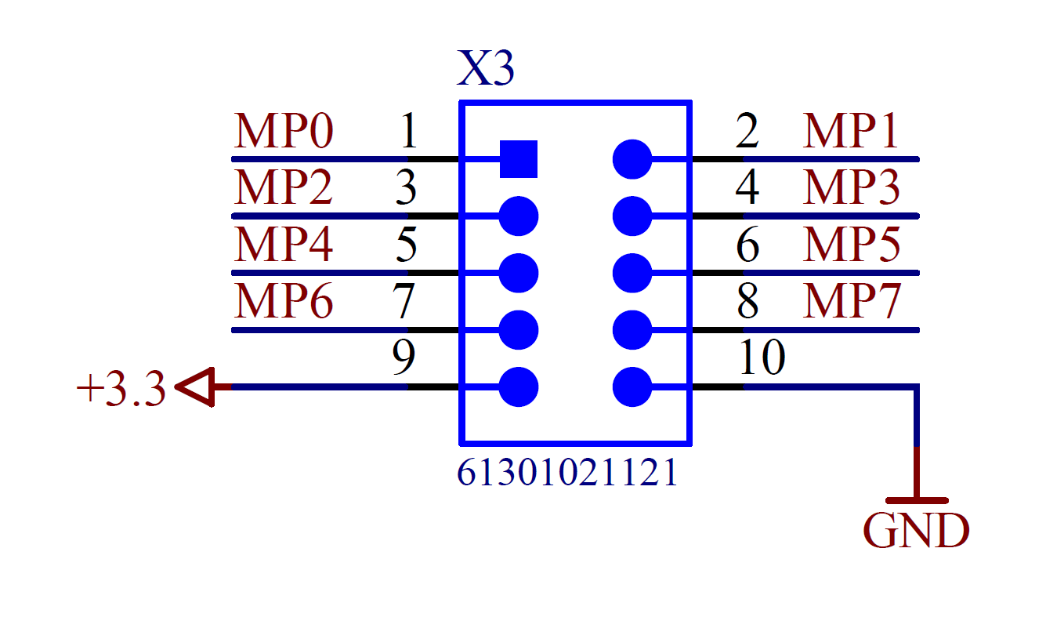
Monitoring

Slide 16

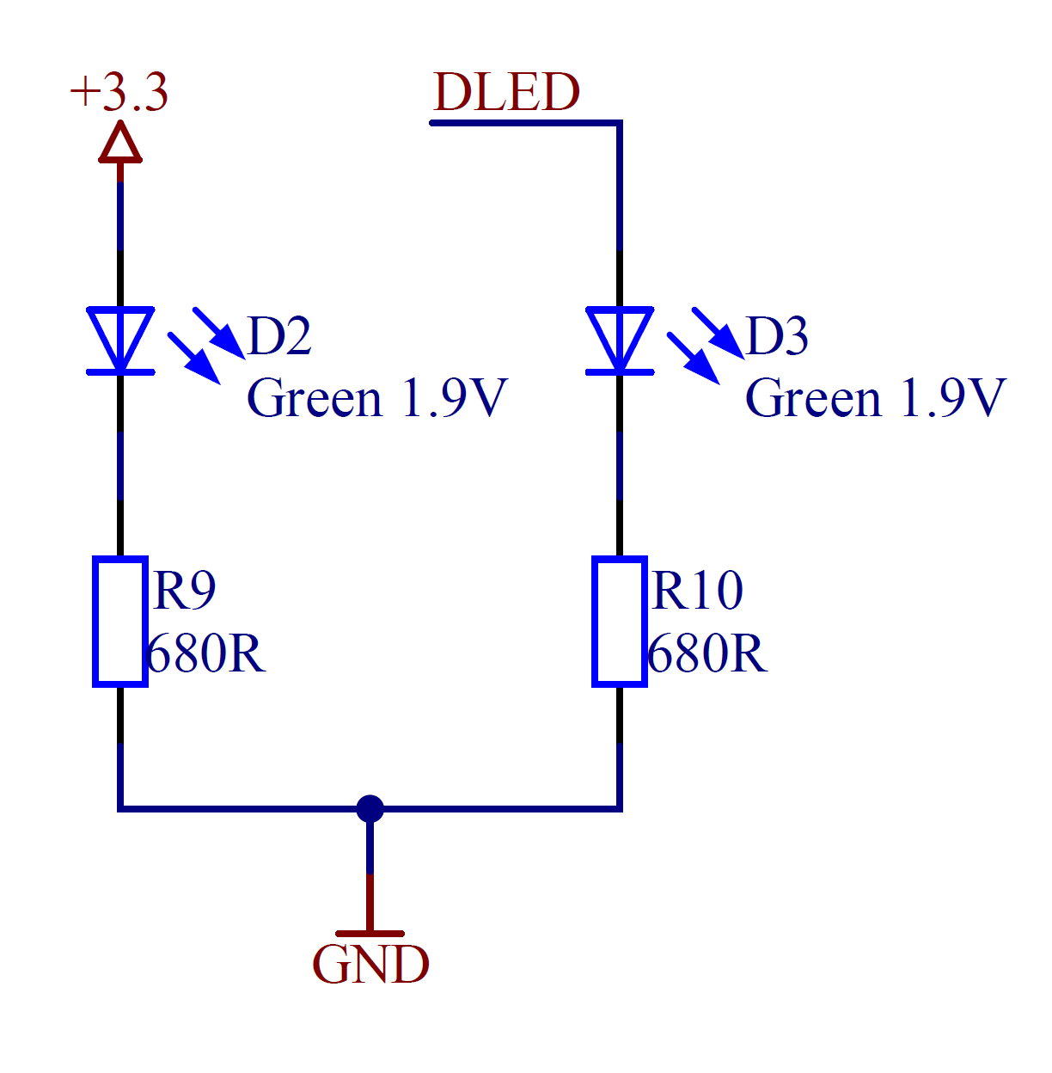

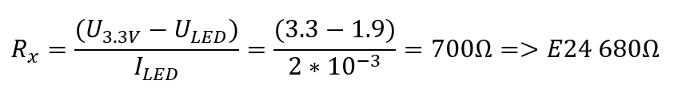
LEDs de vie

Slide 17
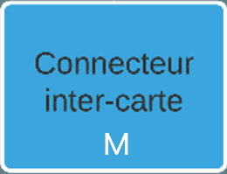
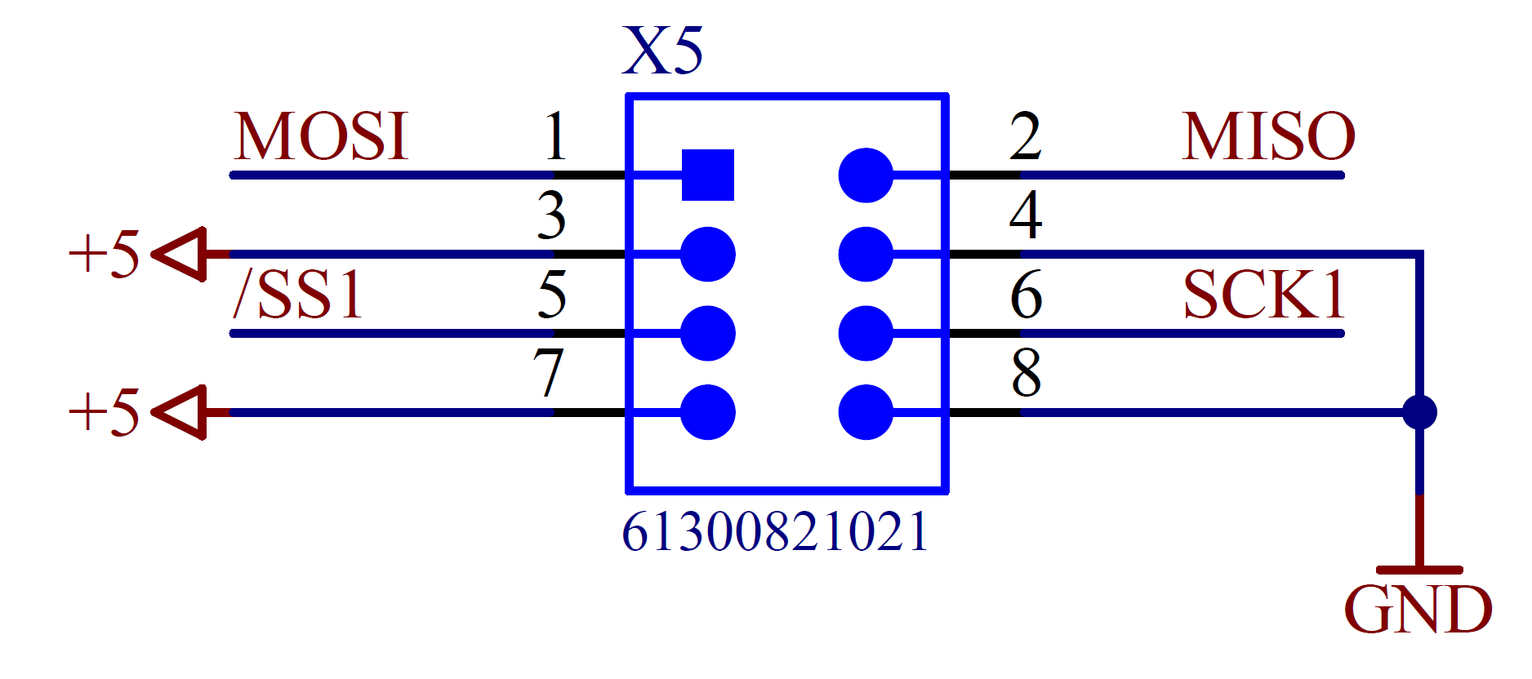
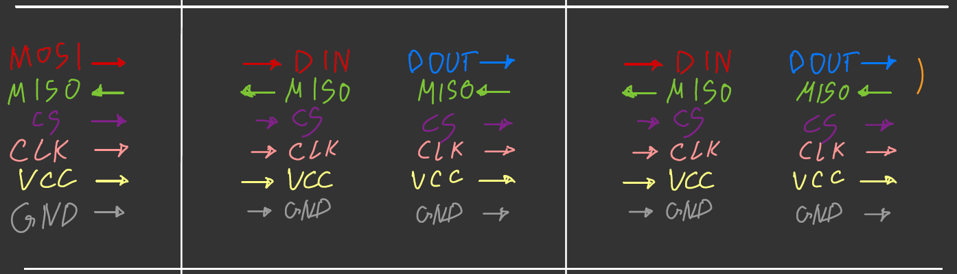
Inter-carte

Slide 18
Modules matrices à LEDs
3
1
2
4

Slide 19
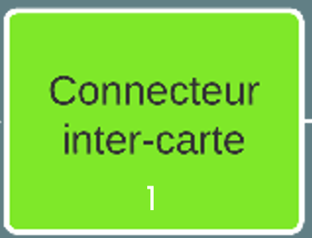
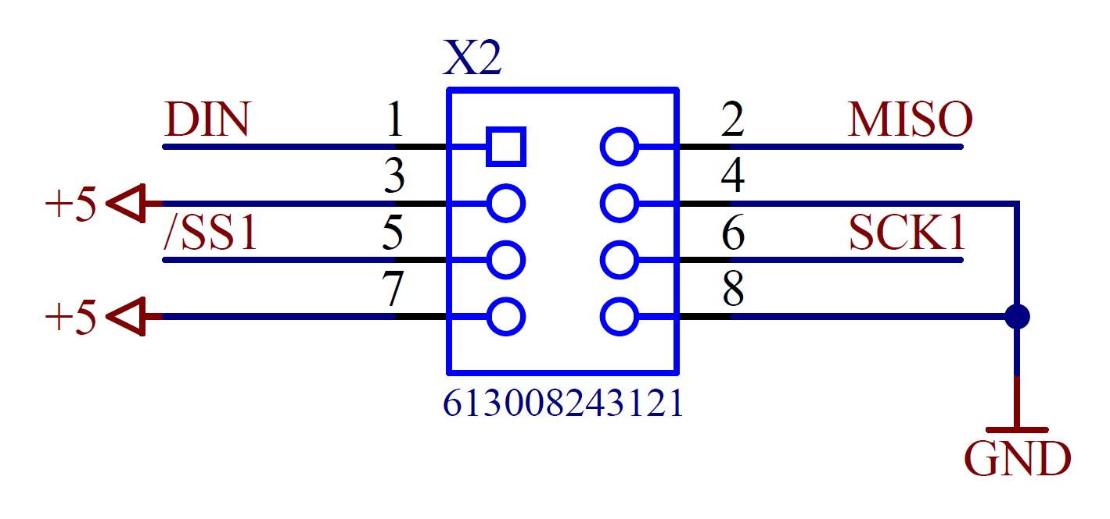
Connecteur IN

Slide 20
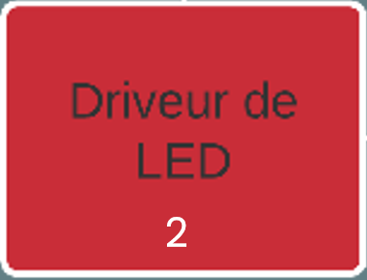
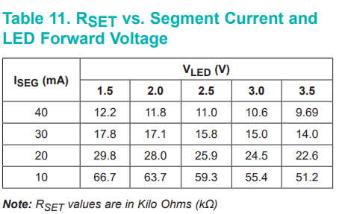
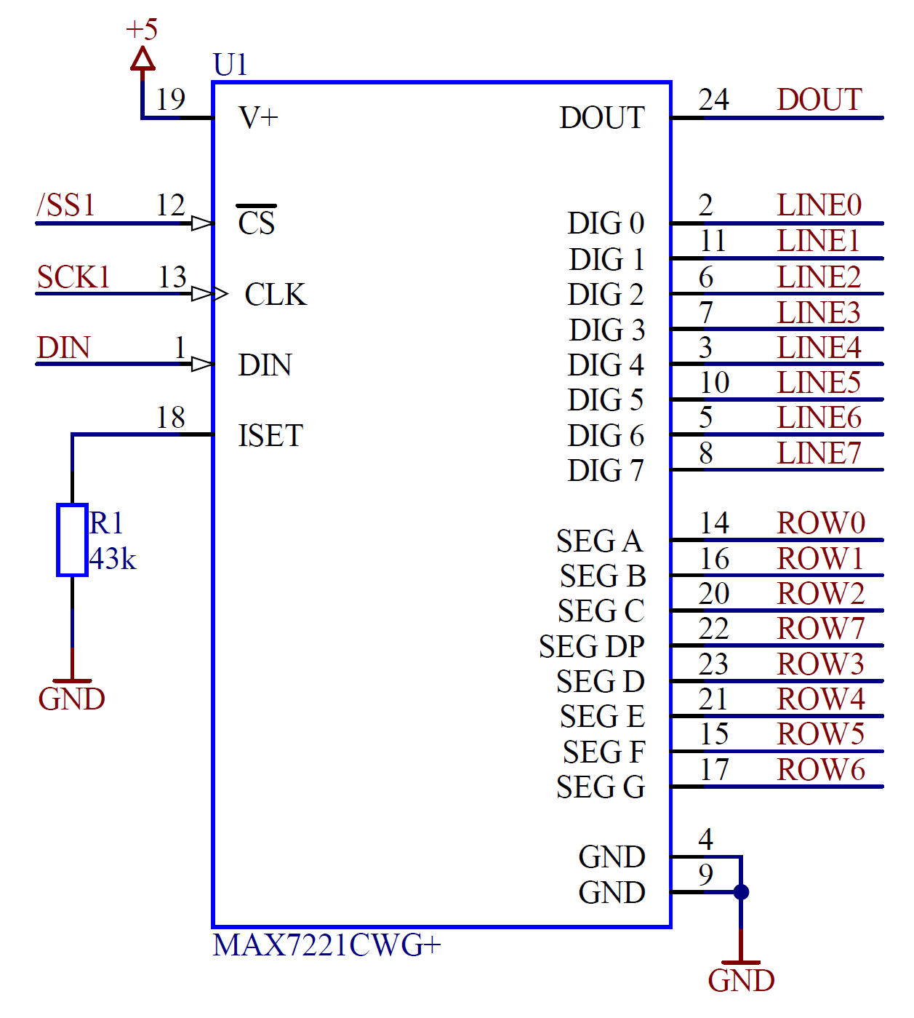
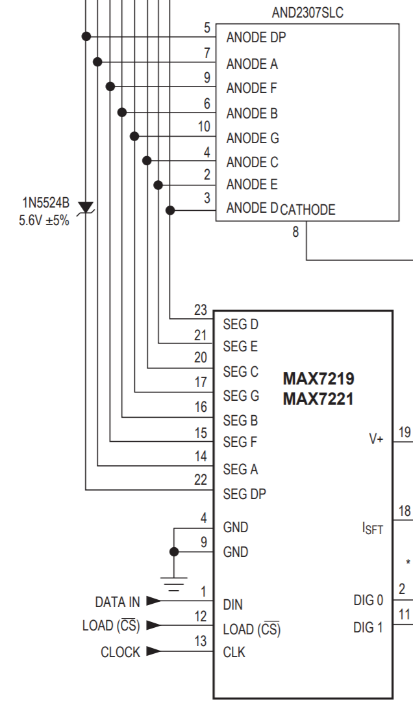
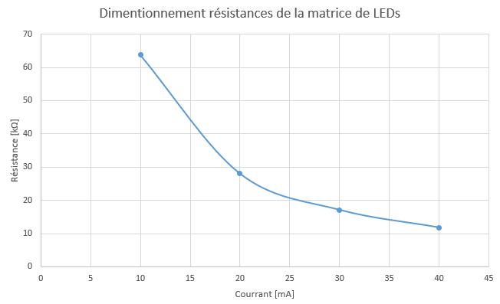
Driveur de LEDs

Slide 21
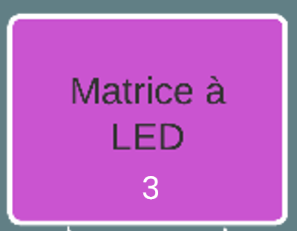
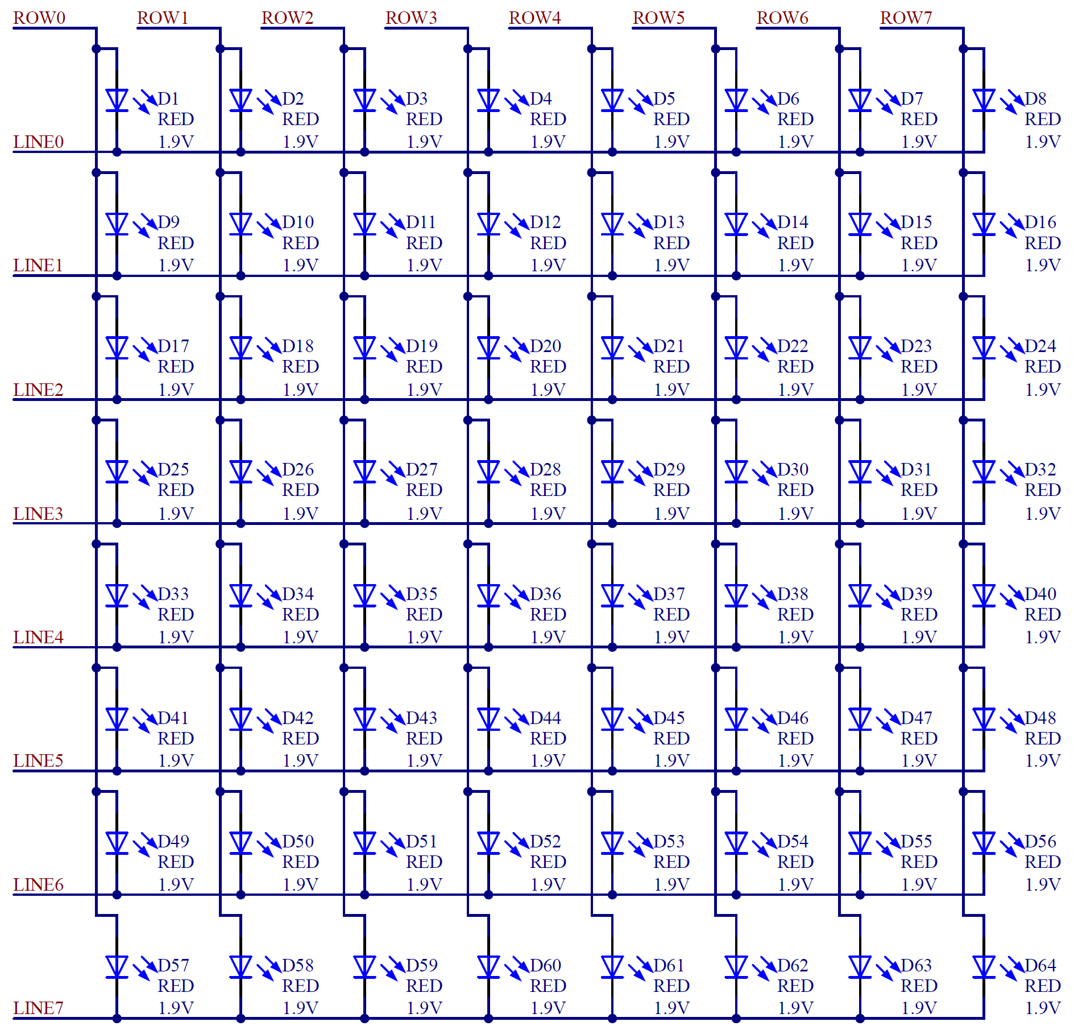
Matrice à LEDs

Slide 22
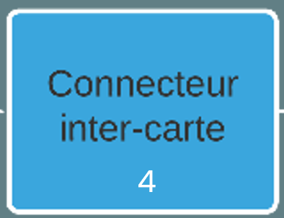
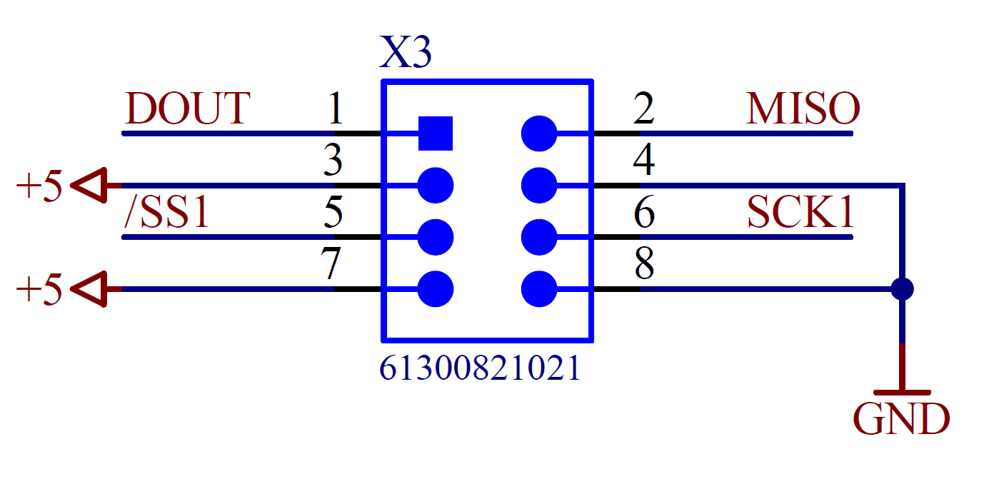
Connecteur OUT

Slide 23

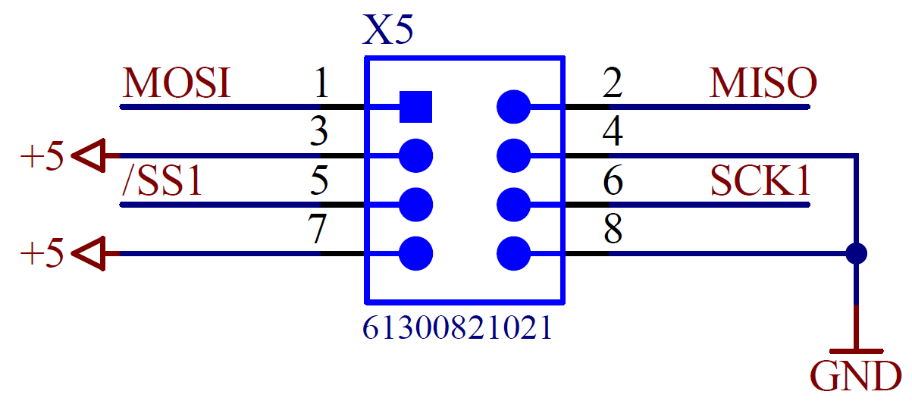
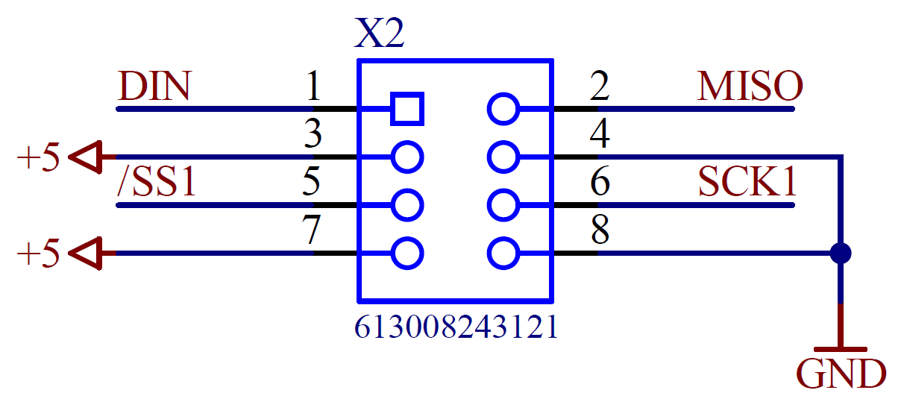


Liaison inter-carte

Slide 24

Concept Software

Slide 25



Concept Firmware

Slide 26

Conclusion

Slide 27

Questions ?

Slide 28
Sources
https://stock.adobe.com/fr/images/micro-usb-cable-usb-cable/187205405?prev_url=detail
https://www.flaticon.com/free-icon/pc_2292038?related_id=2292038&origin=search
https://icon-library.com/icon/usb-port-icon-0.html
https://www.flaticon.com/free-icon/microcontroller_2752878
https://usefulicons.com/useful/dot-matrix-display
https://www.alibaba.com/product-detail/8-position-90-180-degree-male_60619529074.html
https://www.reichelt.com/de/en/10-pin-smd-pin-header-angled-pitch-2-54-sl-1x10w-smd2-54-p51754.html
https://www.infineon.com/dgdl/Infineon-CY7C64225_USB-to-UART_Bridge_Controller-DataSheet-v08_00-EN.pdf?fileId=8ac78c8c7d0d8da4017d0ecca10346da
https://datasheets.maximintegrated.com/en/ds/MAX1793.pdf
https://www.silabs.com/documents/public/application-notes/an0059.0-uart-flow-control.pdf
https://ww1.microchip.com/downloads/en/DeviceDoc/50002081B.pdf
http://ww1.microchip.com/downloads/en/DeviceDoc/PIC32MX1XX2XX-28-36-44-PIN-DS60001168K.pdf

